Slide 1
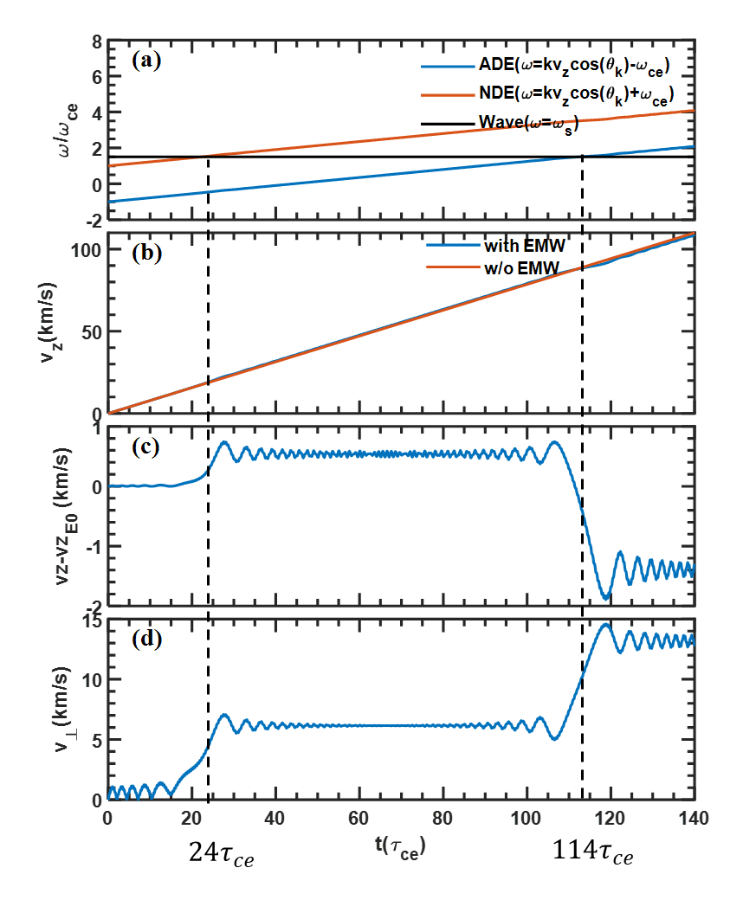


$$24τ_{ce}$$
$$114τ_{ce}$$

Slide 3
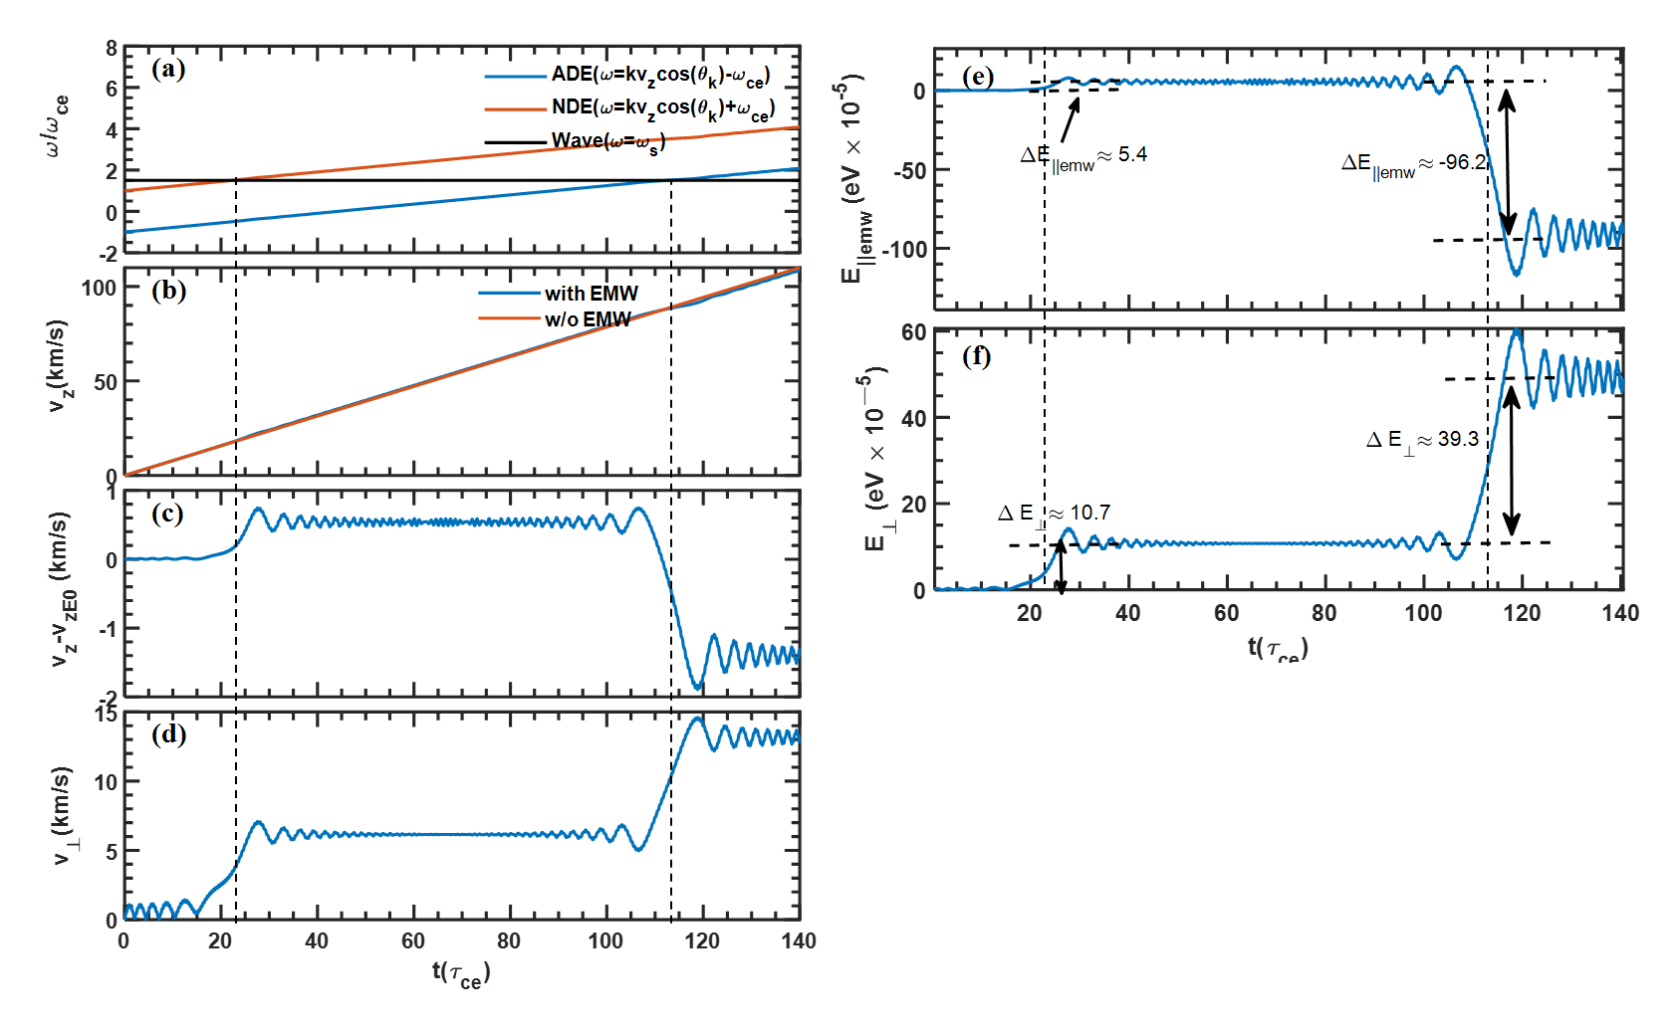

Slide 4
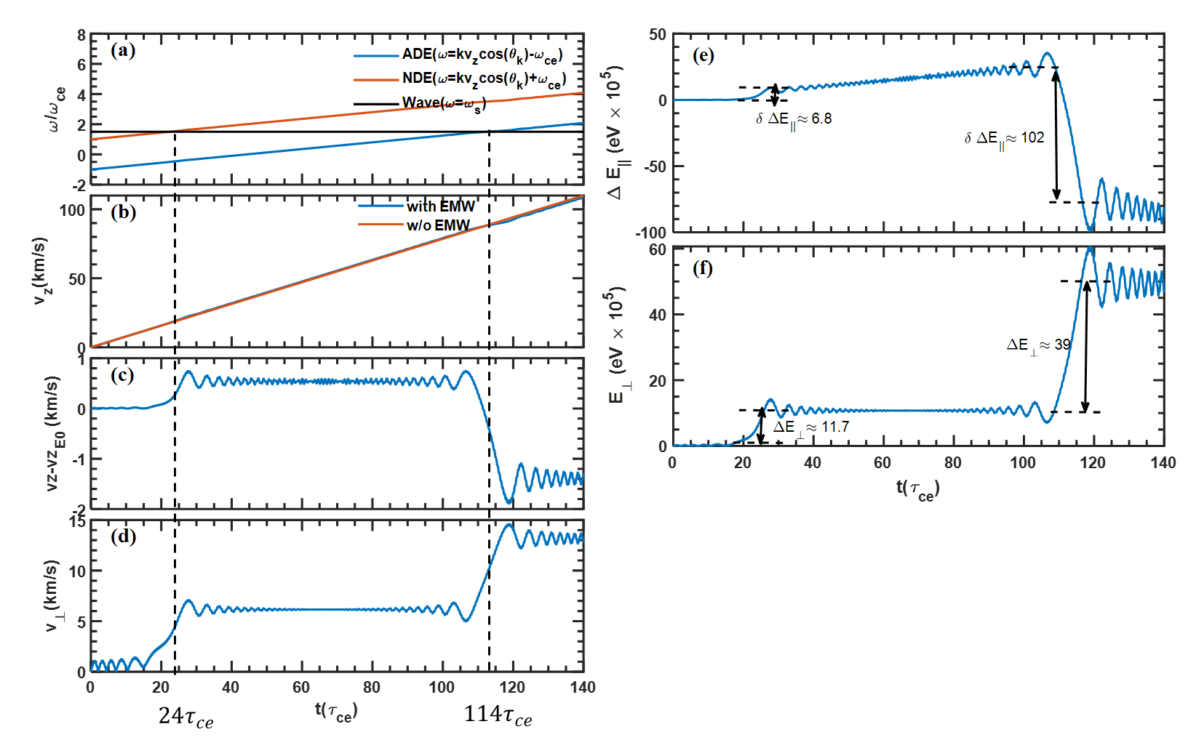

Slide 5
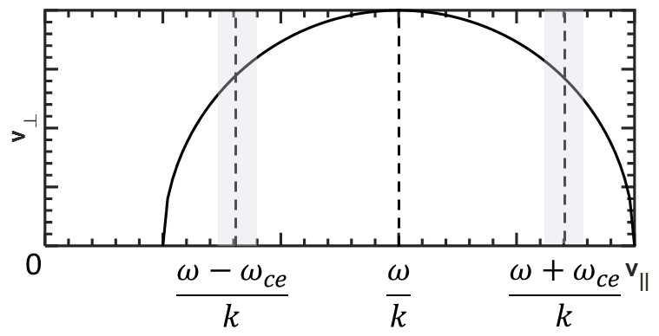



0
$$\frac{ω−ω_{ce}}{k}$$
$$\frac{ω}{k}$$
$$\frac{ω+ω_{ce}}{k}$$

Slide 7
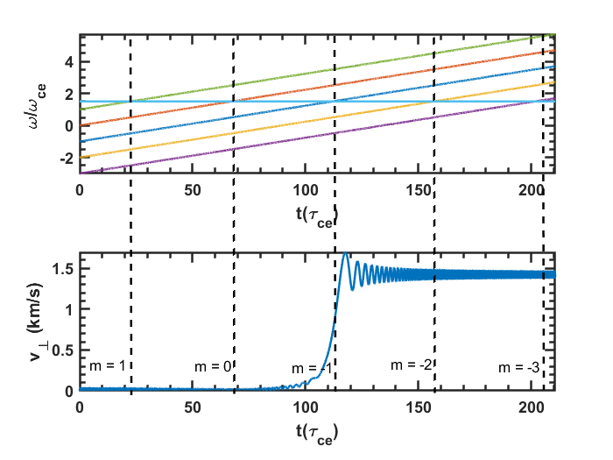
(a)
(b)

